Slide 1
Artificial Neural Network
June 7, 2026

Slide 2
Contents
What is ANN?
Biological Neuron
Structure of Neuron
Types of Neuron
Models of Neuron
Analogy with human NN
Decision Boundary
Activation Function
June 7, 2026

Slide 3
What is ANN?
A neural network can be defined as a model of reasoning based on the human brain.
The brain consists of a densely interconnected set of nerve cells (information processing units) called neurons.
Human brain has 10 billion neurons and 60 trillion connections.
ANN’s are a type of artificial intelligence that attempts to imitate the way a human brain works.
The approach is beginning to prove useful in certain areas that involve recognizing complex patterns,
  such as voice recognition and image recognition.
June 7, 2026

Slide 4
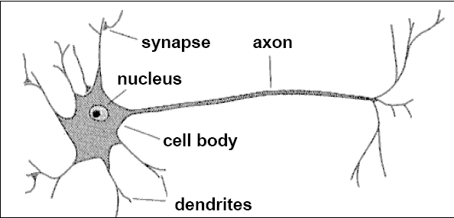
Biological Neuron
A neuron has a cell body, a branching input structure and a branching output structure (the axon)
Axons connect to dendrites via synapses.
Electro-chemical signals are propagated from the dendrites input, through the cell body, and down the axon to other neurons
June 7, 2026

Slide 5
Structure of Neuron
A neuron only fires if its input signal exceeds a certain amount (the threshold) in a short time period.
Synapses vary in strength
  Good connections allowing a large signal
  Slight connections allow only a weak signal.
  Synapses can be either excitatory or inhibitory.
June 7, 2026

Slide 6
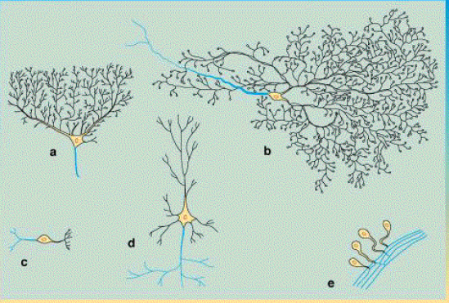
Types of Neuron
Neuron comes in many shapes and sizes
June 7, 2026

Slide 7
Models of Neuron
Neuron is an information processing unit
A set of synapses or connecting links
  –characterized by weight or strength
An adder
  –summing the input signals weighted by synapses
  –a linear combiner
An activation function
  –also called squashing function
    -squash (limits) the output to some finite values
June 7, 2026

Slide 8
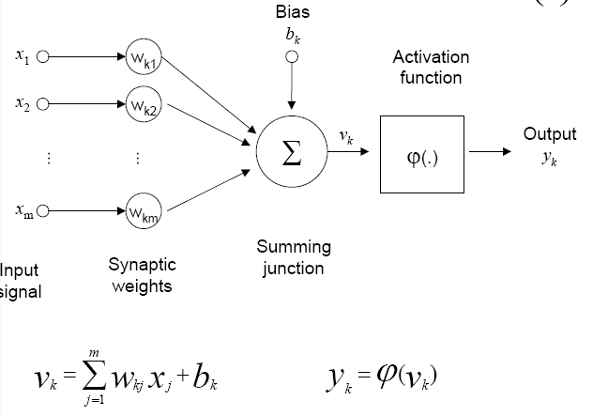
Model of Neuron
June 7, 2026

Slide 9
Analogy
Inputs represent synapses
Weights represent the strengths of synaptic links
Wire presents dendrite secretion
Summation block represents the addition of the secretions
Output represents axon voltage
June 7, 2026

Slide 10
Explanation
Neural Networks use a set of processing elements (or nodes) loosely analogous to neurons in the brain.
These nodes are interconnected in a network that can then identify patterns in data as it is exposed to the data.
In a sense, the network learns from experience just as people do (case of supervised learning).
This distinguishes neural networks from traditional computing programs, that simply follow instructions in a fixed sequential order.
June 7, 2026

Slide 11
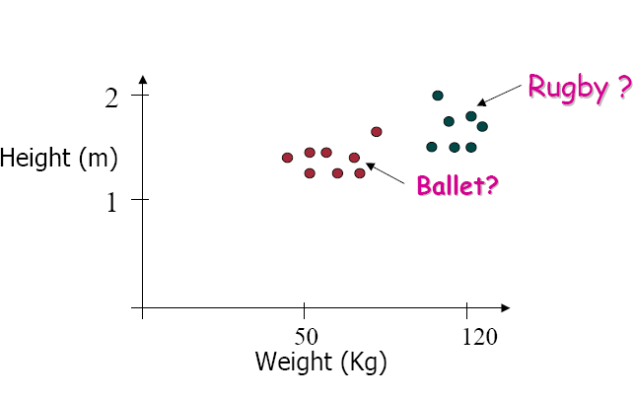
Decision Boundary
June 7, 2026

Slide 12
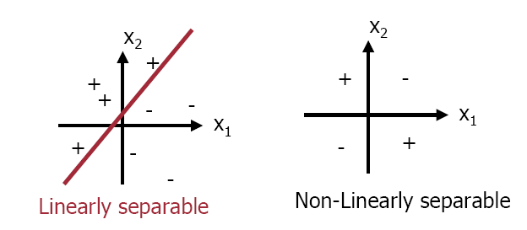
Decision Boundary
Divide feature space by drawing a hyper-plane across it
June 7, 2026

Slide 13
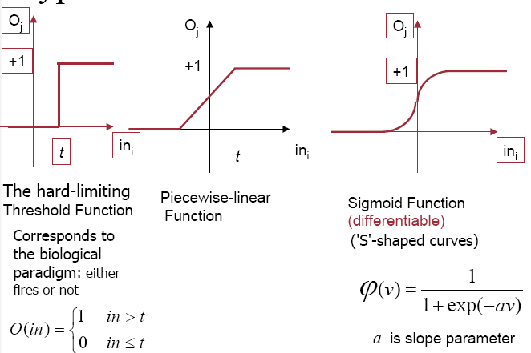
Activation Function
June 7, 2026
Artificial Intelligence, Lecturer #22

Slide 14
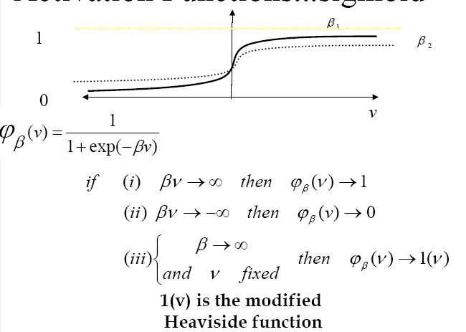
Sigmoid function
June 7, 2026
Artificial Intelligence, Lecturer #22

Slide 15
How Does the Neuron Determine its Output?
The neuron computes the weighted sum of the input signals and compares the result with a threshold value of, T_{h}
If the net weighted input is less than the threshold the neuron output is –1.
If the net weighted input is greater than or equal to the threshold, the neuron becomes activated and its output attains a value +1
(This type of activation function is called a sign function)
June 7, 2026

Slide 16
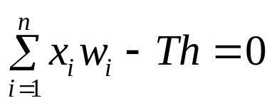
Example of NN: The Perceptron
Single neuron with adjustable synaptic weight and a hard limiter.
Hard Limiter
Linear Combiner
x1
w1
Y-output
Σ
w2
x2
Th
Threshold
Step & sign activation function called hard limit functions.
June 7, 2026

Slide 17
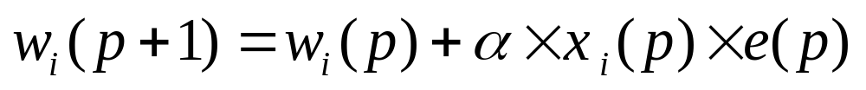
How Does the Perceptron Learn?
Step 1: Initialization
Set the initial weights w₁,w₂,….w_{n} and Threshold-Th
Step 2: Activation
Active the perceptron by applying inputs x₁(p), x₂(p)….. x_{n}(p) and desired output Y_{d}(p). Where p iteration, n number of inputs
Step 3: Weight Training
Update the weight of the perceptron.
Step 4: Iteration
Increase iteration p by one, go back to step 2 and repeat the process.
June 7, 2026

Slide 18
Train a Perceptron to Perform Logical AND operation (1)
Epoch | Inputs |  | Y(d) | Initial Weight |  | Output Y | Error e | Final Weight
 | x1 | x2 | Yd | w1 | w2 |  |  | w1 | w2
1 | 0 | 0 | 0 | 0.3 | -0.1 | 0 | 0 | 0.3 | -0.1
 | 0 | 1 | 0 | 0.3 | -0.1 | 0 | 0 | 0.3 | -0.1
 | 1 | 0 | 0 | 0.3 | -0.1 | 1 | -1 | 0.2 | -0.1
 | 1 | 1 | 1 | 0.2 | -0.1 | 0 | 1 | 0.3 | 0.0
2 | 0 | 0 | 0 | 0.3 | 0.0 | 0 | 0 | 0.3 | 0.0
 | 0 | 1 | 0 | 0.3 | 0.0 | 0 | 0 | 0.3 | 0.0
 | 1 | 0 | 0 | 0.3 | 0.0 | 1 | -1 | 0.2 | 0.0
 | 1 | 1 | 1 | 0.2 | 0.0 | 1 | 0 | 0.2 | 0.0
Threshold=0.2, Learning rate = 0.1
June 7, 2026

Slide 19
Train a Perceptron to Perform Logical AND operation (2)
Epoch | Inputs |  | Y(d) | Initial Weight |  | Output Y | Error | Final Weight
 | x1 | x2 | Yd | w1 | w2 |  |  | w1 | w2
3 | 0 | 0 | 0 | 0.2 | 0.0 | 0 | 0 | 0.2 | 0.0
 | 0 | 1 | 0 | 0.2 | 0.0 | 0 | 0 | 0.2 | 0.0
 | 1 | 0 | 0 | 0.2 | 0.0 | 1 | -1 | 0.1 | 0.0
 | 1 | 1 | 1 | 0.1 | 0.0 | 0 | 1 | 0.2 | 0.1
4 | 0 | 0 | 0 | 0.2 | 0.1 | 0 | 0 | 0.2 | 0.1
 | 0 | 1 | 0 | 0.2 | 0.1 | 0 | 0 | 0.2 | 0.1
 | 1 | 0 | 0 | 0.2 | 0.1 | 1 | -1 | 0.1 | 0.1
 | 1 | 1 | 1 | 0.1 | 0.1 | 1 | 0 | 0.1 | 0.1
Threshold=0.2, Learning rate = 0.1
June 7, 2026

Slide 20
Train a Perceptron to Perform Logical AND operation (3)
Epoch | Inputs |  | Y(d) | Initial Weight |  | Output Y | Error | Final Weight
 | x1 | x2 | Yd | w1 | W2 |  |  | w1 | w2
5 | 0 | 0 | 0 | 0.1 | 0.1 | 0 | 0 | 0.1 | 0.1
 | 0 | 1 | 0 | 0.1 | 0.1 | 0 | 0 | 0.1 | 0.1
 | 1 | 0 | 0 | 0.1 | 0.1 | 0 | 0 | 0.1 | 0.1
 | 1 | 1 | 1 | 0.1 | 0.1 | 1 | 0 | 0.1 | 0.1
Threshold=0.2, Learning rate = 0.1
June 7, 2026

Slide 21
Recommended Textbooks
[Negnevitsky, 2001] M. Negnevitsky “ Artificial Intelligence: A guide to Intelligent Systems”, Pearson Education Limited, England, 2002.
[Russel, 2003] S. Russell and P. Norvig Artificial Intelligence: A Modern Approach Prentice Hall, 2003, Second Edition
[Patterson, 1990] D. W. Patterson, “Introduction to Artificial Intelligence and Expert Systems”, Prentice-Hall Inc., Englewood Cliffs, N.J, USA, 1990.
June 7, 2026

